Slide 1
Operator Overloading
CS1004 Object Oriented Programming

Slide 2
Function Overloading
An overloaded function is one which has the same name but several different forms
For example:
We can overload the constructor for the Date class:
default Date d;
Parametrized (3 ints) Date d(9,22,20);
copy Date d1(d);
Parametrized (1 string, 2 ints) Date d(“Sept”,22,2020);

Slide 3
Operator Overloading
The method of defining additional meanings for operators is known as operator overloading
Enables an operator to perform different operations depending upon the type of operands
The basic operators i.e. +, -, *, / normally works with all primitive types i.e. integers, double, float, int, long.

Slide 4
Operator Overloading
The operator “+” also has different semantics depending on the type of its “arguments”
Example
int i=5, j=7;
i + j; //add two int
double d=5.4, e=3.0;
i + d; //add an int and a double
d + e; //add two doubles

Slide 5
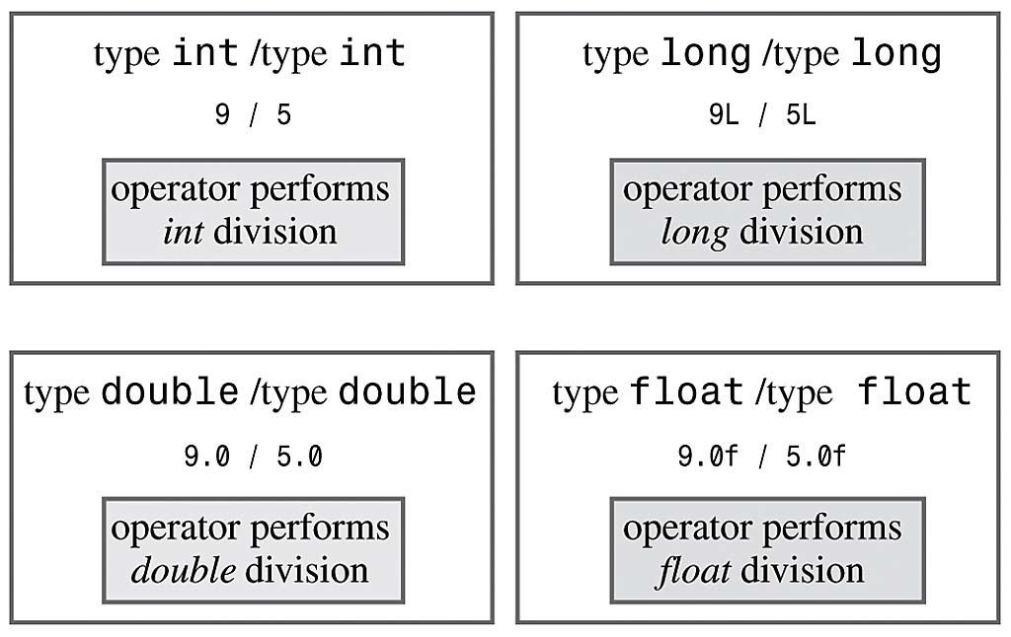
Operator Overloading
Example (already overloaded operator / ):
Same operator has different meaning for different operands

Slide 6
Operator Overloading Motivation
So, can these operators be applied to user-defined data types?
Yes, using Operator overloading:
Enabling C++’s operators to work with class objects
Using traditional operators with user-defined objects
Requires great care; when overloading is misused, program difficult to understand
Notes:
Overloading can be dangerous, for example: do not overload + to subtract, or reimplement ! to make a number negative. So when we say x << 1, we are saying "shift the bits in the variable x left by 1 place. 0011 << 1 is 0110 cout is an object of ostream class and cin is an object istream class. In C++, stream insertion operator “<<” is used for output and extraction operator “>>” is used for input.

Slide 7
How to Overload an Operator?
An operator can be overloaded by declaring a special function
Name of the function is operator followed by operator symbol e.g., operator+, operator/, etc.
operator is a keyword here
Can be a member function of the class (must be non-static)
Can be non-member function (except for the following operators: ( ), [ ], ->,=
Notes:
Can be a member function (must be non-static): to be able to work on objects of the class
If you plan on implementing ->, () or [] they are naturally member methods.
The binary operators = (assignment), [] (array subscription), -> (member access), as well as the n-ary () (function call) operator, must always be implemented as member functions, because the syntax of the language requires them to.

Slide 8
Syntax to Overload an Operator
returnType operator opsymbol(parameters){ }
↑ ↑ ↑ ↑ any type keyword operator symbol function body
Example:
void operator+ (parameters){ }
↑ ↑ ↑ ↑ any type keyword operator symbol function body
return-type may be whatever the operator returns
Operator symbol may be any over-loadable operator

Slide 9
Operator Overloading
Operators are really functions
They have paremeters, they return values
The only difference is operator keyword is used in the function name e.g. operator+, operator[ ]
Overloading provides concise notation:
// without operator overloading object2 = object1.add(object2);
// with operator overloading
object2 = object2 + object1;

Slide 10
Restriction on Operator Overloading
With operator overloading we cannot change:
How operators act on built-in data types:
i.e., cannot change integer addition
Precedence of operator (order of evaluation)
Use parentheses to force order-of-operations
Association rules (left-to-right evaluation)
Number of operands
i.e., & is unary, only acts on one operand
Cannot create new operators
Operators must be overloaded explicitly:
i.e., Overloading + , does not overload +=
Notes:
at least one of the operands has to be of a user-defined type.

Slide 11
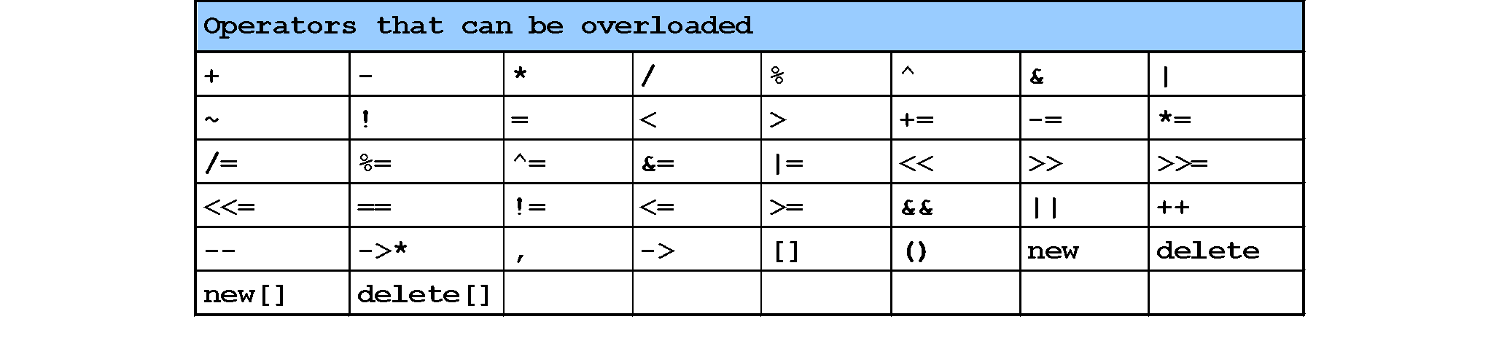
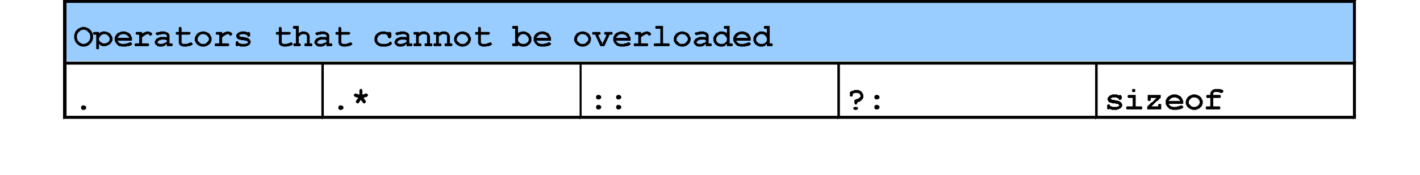
Restriction on Operator Overloading
Notes:
The comma operator (represented by the token, ) is a binary operator that evaluates its first operand and discards the result, it then evaluates the second operand and returns this value (and type). The comma operator has the lowest precedence of any C operator, and acts as a sequence point.
->* is an operator to operate on function pointers
https://isocpp.org/wiki/faq/operator-overloading#overload-dot
http://www.stroustrup.com/bs_faq2.html#overload-dot
There is no fundamental reason to disallow overloading of ?:. I just didn't see the need to introduce the special case of overloading a ternary operator. Note that a function overloading expr1?expr2:expr3 would not be able to guarantee that only one of expr2 and expr3 was executed.
Sizeof cannot be overloaded because built-in operations, such as incrementing a pointer into an array implicitly depends on it. Consider:
Operator . (dot) could in principle be overloaded using the same technique as used for ->. However, doing so can lead to questions about whether an operation is meant for the object overloading . or an object referred to by . For example:

Slide 12
How to Overload an Operator?
Member function: If the left operand of that particular operator is an object of the same class, then the overloaded operator is said to be implemented by a member function.
Non-member function: If the left operand of that particular operator is an object of a different class, then the overloaded operator is said to be implemented as a non-member function
Notes:
A unary operator @, applied to an object x, is invoked either as operator@(x) [non member implementation] or as x.operator@() [member implementation].
A binary infix operator @, applied to the objects x and y, is called either as operator@(x,y) [non-member implementation] or as x.operator@(y) [member implementation]

Slide 13
Invoking Objects
If the operator is binary but there is only one explicit argument, the calling object is assumed to be the left operand
class Date
{
public: // member functions
Date operator-(Date& d);
};
int main (void)
{
s1 - s2; // instead of s1.operator-(s2);
}

Slide 14
Operator Overloading Syntax
a = b + c;
datatype operator+ (datatype) { … }
Parameter or Right operand in member functions (can be native data type or user defined data type)
Remember operator+ is a function, and it will be called with the help of any object, thus for member functions the left operand is the calling object
return parameter
(can be native data type or user defined data type)

Slide 15
Operator Overloading Syntax
datatype operator+ (datatype)
Example (1): parameter of primitive data type
return value of primitive data type
class myClass
{
int operator+ ( int );
}
int main ( )
{
int a,b=5;
myClass object1;
a = object1 + b;
}

Slide 16
Operator Overloading Syntax
datatype operator+ (datatype)
Example (2): parameter of user defined data type
return value of primitive data type
class myClass
{
int operator+ ( myClass &a );
}
int main ( )
{
int a;
myClass object1, object2;
a = object1 + object2;
}

Slide 17
Operator Overloading Syntax
datatype operator+ (datatype)
Example (3): parameter of primitive data type
return value of user defined data type
class myClass
{ myClass operator+ ( int ); }
int main ( )
{
int a = 5;
myClass object1, object2;
object2 = object1 + a;
}

Slide 18
Operator Overloading Syntax
datatype operator+ (datatype)
Example (4): parameter of user defined data type
return value of user defined data type
class myClass
{
myClass operator+ ( myClass &a );
}
int main ( )
{
myClass object1, object2, object3;
object3 = object1 + object2;
}

Slide 19
Overload as Member or Non-Member Function
Rule of Thumb:
If it is a unary operator, implement it as a member function.
If a binary operator treats both operands equally (it leaves them unchanged), implement this operator as a non-member function.
If a binary operator does not treat both of its operands equally (usually it will change its left operand), it might be useful to make it a member function of its left operand’s class

Slide 20
Operator Overloading
Relational operators are also binary and can be overloaded in the same way
< , > , <= ,>= , ==
To add operator functionality in the class
First create a function for the class
Set the name of the function with the operator name
operator+ for the addition operator ‘+’
operator> for the comparison operator ‘>’

Slide 21
Overloading > operator
bool Employee::operator>(Employee& e)
{
return(seniority > e.getSeniority());
}
called from the program like this:
if (emp1 > emp2)

Slide 22
Implementing Overloaded Operators
The compiler uses the types of arguments to choose the appropriate overloading.
int v1, v2;
v1 + v2; // int +
float s1, s2;
s1 + s2; // float+

Slide 23
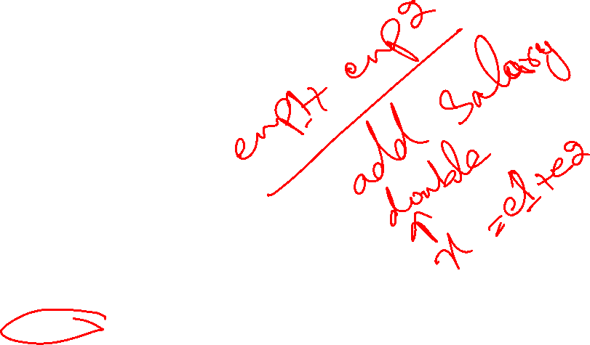
Extended Example
Employee class and objects
class Employee
{
private:
int idNum;
double salary;
public:
Employee(int id, double salary);
double addTwo (Employee& emp);
double operator+ (Employee& emp);
double getSalary() { return salary; }
};

Slide 24
The member functions ‘addTwo’ and operator+
//function notation
double Employee::addTwo(Employee& emp)
{
double total;
total = this->salary + emp.getSalary();
return total;
}
//operator overloading notation
double Employee::operator+(Employee& emp)
{
double total;
total = this->salary + emp.getSalary();
return total;
}

Slide 25

Using the Member Functions
double sum;
Employee Clerk (111, 10000), Driver (222, 6000);
// these three statements do the same thing
sum = Clerk.addTwo(Driver);
sum = Clerk.operator+(Driver);
sum = Clerk + Driver;
// the syntax for the last one is the most natural
// and is easy to remember because it is consistent
// with how the + operator works for everything else

Slide 26
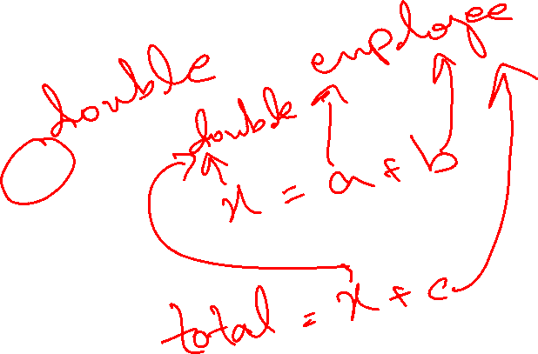
Multiple Operators
Often, you may need to reference an operator more than once in an expression:
Example:
total = a + b + c;
But this can cause problems when operator overloading is involved
See next example…

Slide 27
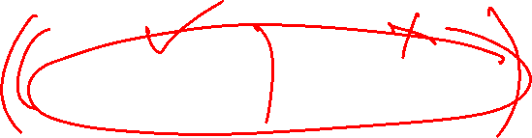
Client Code for Class Employee
void main()
{
Employee Clerk(115, 20000.00);
Employee Driver(256, 15500.55);
Employee Secretary(567, 34200.00);
double sum;
sum = Clerk + Driver + Secretary;
cout << “Sum is “ << sum;
}

Slide 28

The Problem
Operator + is left to right associative, so Clerk and Driver are added. The result is a double.
double + Secretary; //ERROR
The overloaded operator+ function is a member of the employee class.
Left operand MUST be an object of Employee class.

Slide 29

The Problem Gets Worse
There are two ways to make this work for
non-member function
Friend function
To be discussed later…
A member function CANNOT overload an operator like this:
Primitive data type + User-defined data type //ERROR
double + Employee
sum = num + Secretary; // why not?
Whenever an operator is overloaded as a member function. The left operand must be of that SAME class.
Here the left operand is a double, we cannot create an overloaded function in the double class

Slide 30
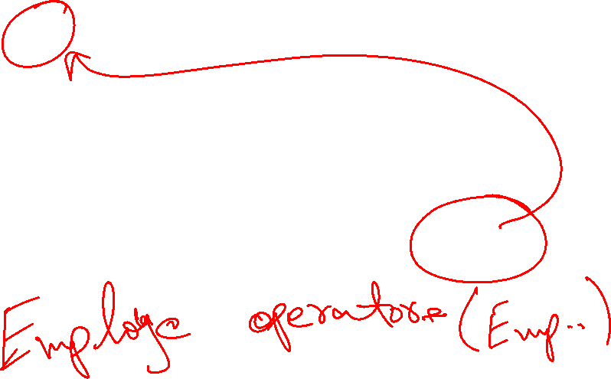
Solution 1
Good practice that all your arithmetic binary operators (+ - * / %) when overloaded should return an object
sum = Clerk + Driver + Secretary;
Make sure that your operator+ function never returns a double (or any other primitive type).
An operator to add Employees should return an Employee object.

Slide 31

Solution 1
Employee class and objects
class Employee
{
private:
int idNum;
double salary;
public:
Employee(int id, double salary);
Employee operator+ (Employee& emp);
double getSalary() { return salary; }
}

Slide 32

Solution Example
Employee Employee::operator+(Employee& emp)
{
double sal = salary + emp.salary;
Employee total(0, sal);
return total; //returns an object
}
void main()
{
Employee Clerk(115, 20000.00);
Employee Driver(256, 15500.55);
Employee Secretary(567, 34200.00);
Employee sum(0, 0.0);
sum = Clerk + Driver + Secretary;
}

Slide 33
Solution 2
sum = Clerk + Driver + Secretary;
Make a non-member operator+ function that returns an Employee object.

Slide 34
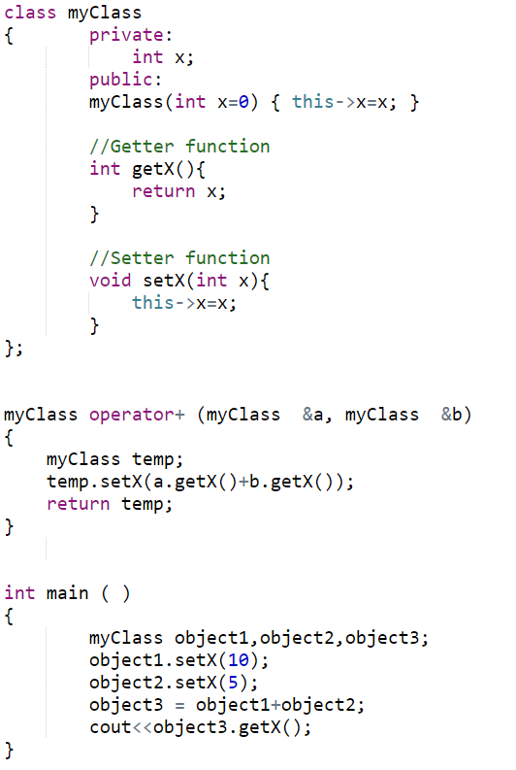
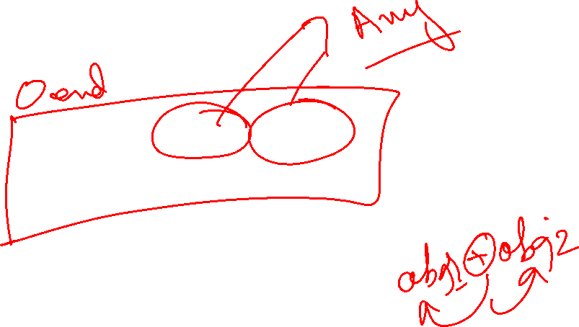
Non-member Operator Overloading Function

Slide 35
Assignment Operator =
Operator = is overloaded implicitly for every class, so they can be used for each class objects.
Recall default copy constructor
operator = performs member-wise copy of the data members.
However, there is a problem with implicitly overloaded operator=
Recall shallow copy
Notes:
Yes, if class contains pointers (dynamic allocations) to ensure a Deep Copy

Slide 36
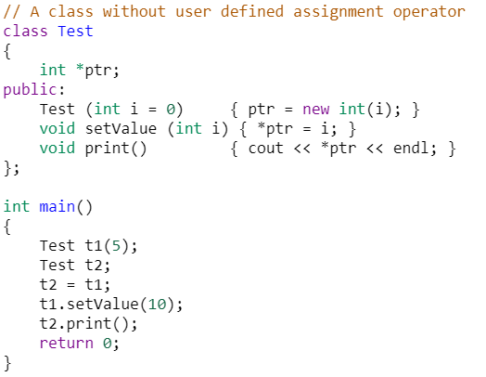
Using implicit Overloaded Assignment Operator
Notes:
Output = 10
https://www.geeksforgeeks.org/assignment-operator-overloading-in-c/

Slide 37
Assignment Operator =
Assignment operator can ONLY be overloaded as a member function
class Employee
{ private:
int idNum;
double salary;
public:
Employee ( ) { idNum = 0, salary = 0.0; }
void setValues (int a, int b);
void operator= (double); //prototype
}
void Employee::setValues ( int idN , double sal )
{
salary = sal; idNum = idN;
}
void Employee::operator= (double sal)
{ salary = sal; }

Slide 38
Assignment Operator =
int main ( )
{
Employee emp1;
emp1.setValues(10,33.5);
Employee emp2;
emp2 = 44.6; // emp2 is calling object
}
Overloaded as a member function so left operand must be an object of the same class
Right operand a double (parameter of the overloaded = function)

Slide 39
Assignment Operator =
class Employee
{ private:
int idNum;
double salary;
public:
Employee ( ) { idNum = 0, salary = 0.0; }
void setValues (int a, int b);
double getSalary() { return salary }
void operator= (Employee &emp );
}
void Employee::setValues ( int idN , double sal )
{ salary = sal; idNum = idN; }
void Employee::operator = (Employee &emp)
{ salary = emp.getSalary(); }

Slide 40
Assignment Operator =
int main ( )
{
Employee emp1;
emp1.setValues(10,33.5);
Employee emp2;
emp2 = emp1; // emp2 is calling object
}

Slide 41
int main()
{ myClass c1(-3);
myClass c2(5);
//copy constructor will be called at
//object creation
myClass c3 = c2;
cout << c3.getA();
//overloaded = operator function called
c1 = c2;
cout << c1.getA();
return 0;
}
class myClass {
int a;
public:
myClass(int x) {
a = x;
}
myClass(myClass& m) {
cout << "copy constructor" << endl;
a = m.a;
}
int getA() {
return a;
}
void setA(int aa) {
a = aa;
}
void operator=(myClass& c) {
cout << "\nOverloaded = function" << endl;
this->a = c.a;
}
};
copy constructor
5
Overloaded = function
5

Slide 42
int main()
{ myClass c1(-3);
myClass c2(5);
//copy constructor will be called at
//object creation
myClass c3 = c2;
cout << c3.getA();
//overloaded = operator function called
c1 = c2; //c1.operator=(c2);
//c1 is unchanged
cout << c1.getA();
return 0;
}
class myClass {
int a;
public:
myClass(int x) {
a = x;
}
myClass(myClass& m) {
cout << "copy constructor" << endl;
a = m.a;
}
int getA() {
return a;
}
void setA(int aa) {
a = aa;
}
myClass operator=( const myClass& c) {
myClass m(0);
cout << "\nOverloaded = function" << endl;
m.a = c.a;
return m; }
};
copy constructor
5
Overloaded = function
-3

Slide 43
Comparison Operator ==
class Employee
{ private:
int idNum;
double salary;
public:
Employee ( ) { idNum = 0, salary = 0.0; }
void setValues (int a, int b);
double getSalary() { return salary }
bool operator== ( Employee &emp );
}
void Employee::setValues ( int idN , double sal )
{ salary = sal; idNum = idN; }
bool Employee::operator == (Employee &emp)
{ return (salary == emp.getSalary()); }

Slide 44
Comparison Operator ==
class Employee
{ private:
int idNum;
double salary;
public:
Employee ( ) { idNum = 0, salary = 0.0; }
void setValues (int a, int b);
double getSalary() { return salary }
}

Slide 45
Comparison Operator ==
int main ( )
{
Employee emp1;
emp1.setValues(10,33.5);
Employee emp2;
emp2.setValues(10,33.1);
if ( emp2 == emp1 )
cout <<“Both objects have equal value”;
else
cout <<“objects do not have equal value”;
}

Slide 46
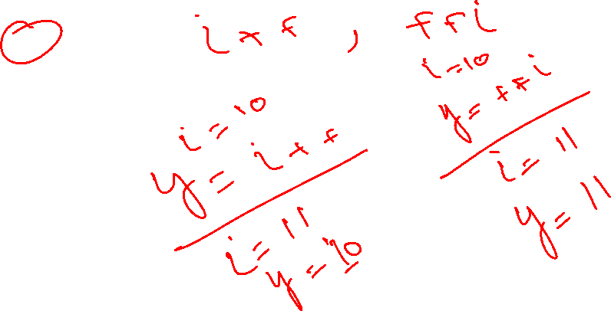
Operator Overloading Syntax
Syntax of an overloaded operator function:
datatype operator+ (datatype)
However, for some operators, this syntax will be slightly different:
++, -- operators
>>, << operators
& and [ ] operators

Slide 47
Overloading ++ and --
Operator ++ and -- are different to other operators of C++
We can call them:
either in the form of prefix (++i) before an object
or in the form of postfix (i++) after an object
But in both cases, the calling object will be i.

Slide 48
i++ and ++i ?
Prefix makes the change, and then processes the variable
Postfix processes the variable, then makes the change.
i = 1;
j = ++i;
(i is 2, j is 2)
i = 1;
j = i++;
(i is 2, j is 1)

Slide 49
Overloaded ++
class Inventory
{
private:
int stockNum;
int numSold;
public:
Inventory(int stknum, int sold);
void operator++();
};
void Inventory::operator++()
{
numSold++;
}

Slide 50
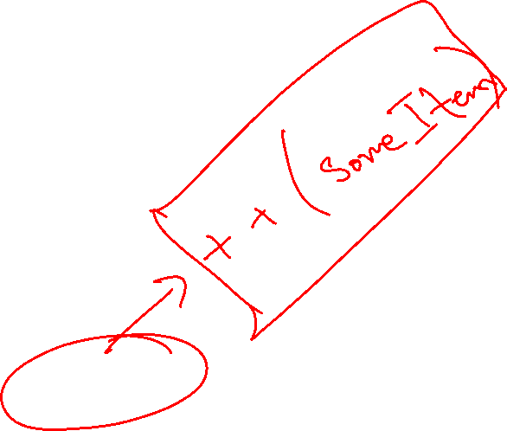
Use of the operator ++
int main ( )
{
Inventory someItem(789, 84);
// the stockNum is 789
// the numSold is 84
++someItem;
Inventory Item2 = ++someItem;
//will this instruction work
// Will not work as the overloaded function does not return anything
}

Slide 51
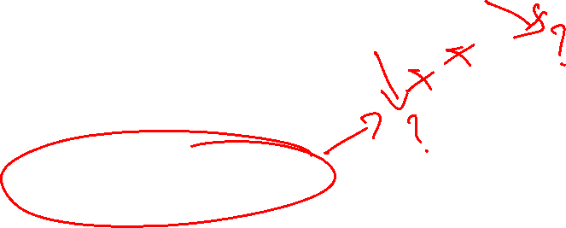
Overloaded ++
class Inventory
{
private:
int stockNum;
int numSold;
public:
Inventory(int stknum, int sold);
Inventory& operator++();
};
Inventory& Inventory::operator++()
{
Inventory *object = new Inventory(0,0);
numSold++;
object->numSold = numSold;
return(*object);
}

Slide 52
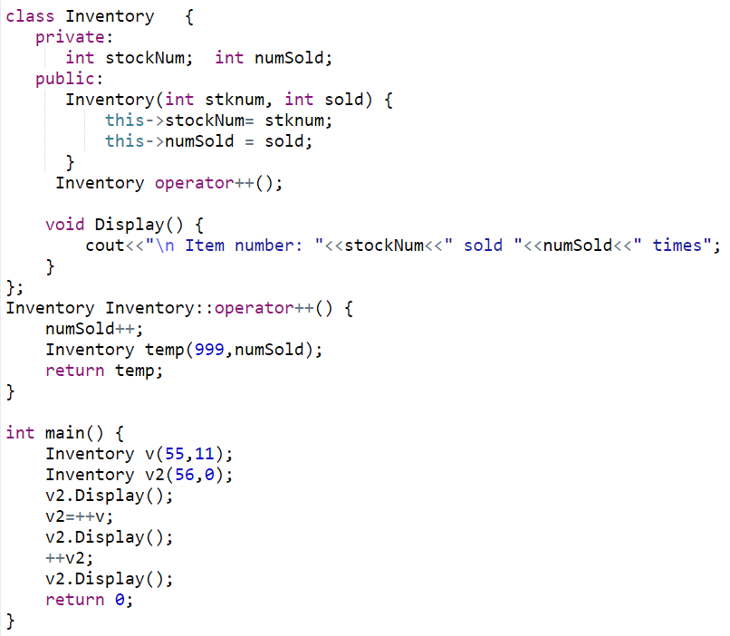

Using ++ (Prefix Notation)

Slide 53
Problem
The definition of the prefix operator is simple. It increments the value before any other operation.
But, how will C++ be able to tell the difference between a prefix ++ operator and a postfix ++ operator?
Answer: overloaded postfix operator will take a dummy argument (just for differentiation between postfix and prefix).

Slide 54
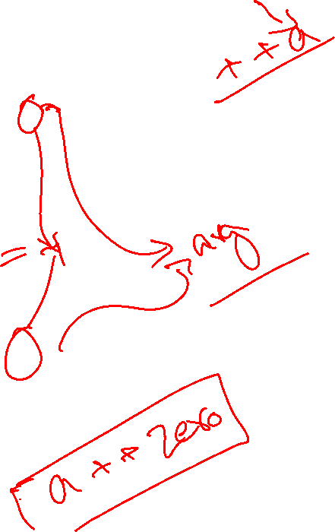
Postfix operator
Inventory& Inventory::operator++() // prefix version
{
Inventory *object = new Inventory(0,0);
numSold++;
object->numSold = numSold;
return(*object);
}
Inventory& Inventory::operator++(int) // postfix version
{
Inventory *object = new Inventory(0,0);
object->numSold = numSold;
numSold++;
return(*object);
}
dummy argument

Slide 55
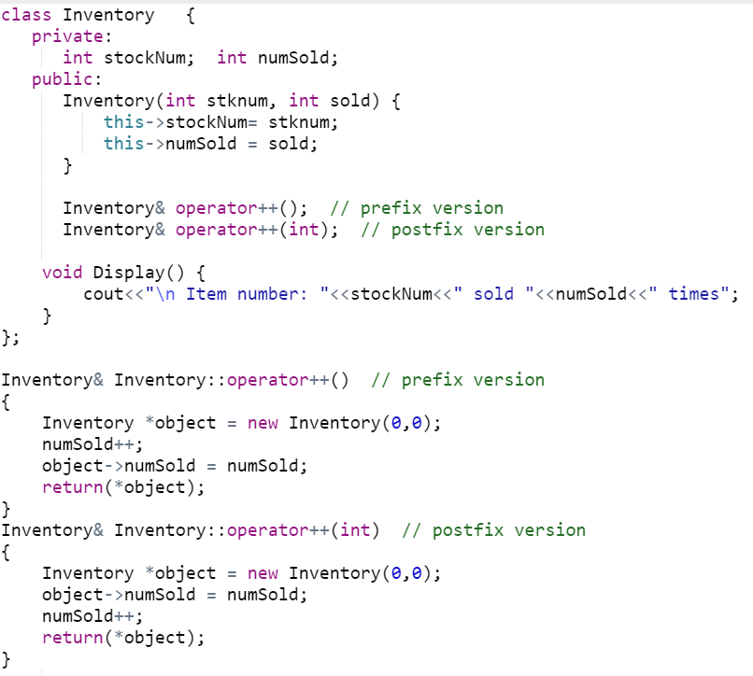

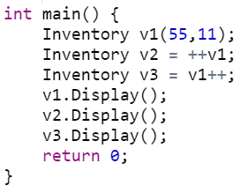
Postfix and Prefix ++

Slide 56
Subscript operator [ ]
With the help of [ ] operator, we can define array style syntax for accessing or assigning individual elements of classes
Student semesterGPA;
semesterGPA[0] = 3.5;
semesterGPA[1] = 3.3;

Slide 57

Subscript operator[ ]
class Student
{ private:
double gpa[8];
public:
Student ()
{ gpa[0]=3.5; gpa[1]=3.2; gpa[2]=4; gpa[3]=3.3;
gpa[4]=3.8; gpa[5]=3.6; gpa[6]=3.5; gpa[7]=3.8;
}
double& opeator[] (int Index);
}
double& Student::operator [ ] (int Index)
{
return gpa[Index];
}

Slide 58
Subscript operator[ ]
int main ( )
{
Student semesterGPA;
semesterGPA[0] = 3.7;
double gpa = semesterGPA[4];
}

Slide 59
Subscript operator[ ]
How does this statement execute?
semesterGPA[0] = 3.7;
The [ ] has higher priority than the assignment operator, therefore semesterGPA[0] is processed first.
semesterGPA[0] calls operator [ ], which then return a reference of semesterGPA.gpa[0].

Slide 60
Subscript operator[ ]
The return value is reference to semesterGPA.gpa[0], and the statement semesterGPA[0] = 3.7 is actually integer assignment
int main ( )
{
Student semesterGPA;
semesterGPA[0] = 3.7;
// the above statement is processed like as
semesterGPA.gpa[0] = 3.7
}

Slide 61
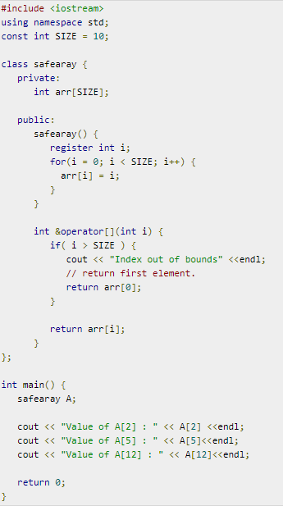
Notes:
Register is a request to compiler to store in register-memory instead of memory. Compiler may or may not do that.
https://www.tutorialspoint.com/cplusplus/subscripting_operator_overloading.htm

Slide 62
Parenthesis operator ()
Can only be overloaded as a member function
Can have any return type
Can have zero or more parameters
Implement any logic in the function

Slide 63
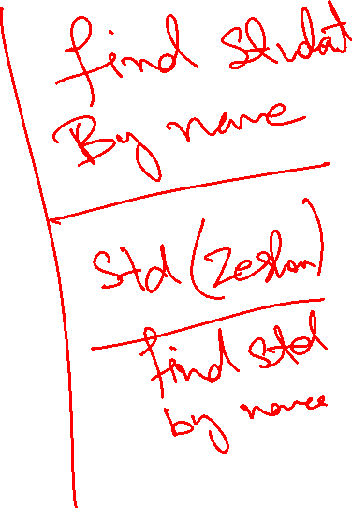
int main()
{
//constructor called
myClass c1(15);
//overloaded () called
int ind = c1('m’);
cout<<"Index of 'm' is: "<<ind;
return 0;
}
class myClass {
int a;
char arr[15] = "something";
public:
myClass(int x) {
cout << "\nConstructor called" << endl;
a = x;
}
myClass(myClass& m) {
cout << "copy constructor" << endl;
a = m.a;
}
int getA() {
return a;
}
void setA(int aa) {
a = aa;
}
int operator()(char find ) {
cout << "\nOverloaded () called" << endl;
for (int i = 0; arr[i] != '\0'; i++) {
if (arr[i] == find)
return i;
}
return -1;
}
};
Constructor called
Overloaded () called

Slide 64
int main()
{
myClass c1(15),c3(0);
//constructor called
c1(c3);
//overloaded () called
myClass c2(c1);
//copy constructor called
return 0;
}
class myClass {
int a;
char arr[15] = "something";
public:
myClass(int x) {
cout << "\nConstructor called" << endl;
a = x;
}
myClass(myClass& m) {
cout << "copy constructor" << endl;
a = m.a;
}
int getA() {
return a;
}
void setA(int aa) {
a = aa;
}
int operator()(myClass &find) {
cout << "\nOverloaded () called" << endl;
return -1;
}
};
Constructor called
Constructor called
Overloaded () called
copy constructor

Slide 65

new vs new[ ] operator overloaded
class myClass {
int a;
char arr[15] = "something";
public:
myClass(int x=0) {
cout << "\nConstructor called" << endl;
}
myClass(const myClass& m) {
cout << "copy constructor" << endl;
a = m.a;
}
int getA() {
return a;
}
void setA(int aa) {
a = aa;
}
void* operator new(size_t s) {
cout << "\nOverloaded new called" << endl;
void* p =:: operator new(s); //:: calls standard new operator
return p;
}
void* operator new[](size_t s) {
cout << "\nOverloaded new [] called" << endl;
void* p = ::operator new[](s); //:: calls standard new [] operator
return p;
}
};
int main()
{
myClass *p=new myClass[5];
//calls overloaded new []
p = new myClass;
//calls overloaded new
}

Slide 66
Calling an overloaded operator from native data types
int var;
Point object;
var = var + object;
In above example, it seems that we need to overload + operator for integer (native-data type).
But in operator overloading we can't change the functionality of integer (or any primitive) data type

Slide 67

Calling an overloaded operator from native data types
Friend functions can help solve this problem.
A Friend function does not need an object of a class for its calling.
Thus, with a simple trick we can set parameter1 of an overloaded operator to a native data type and parameter2 to class object.

Slide 68
Friend Functions
Friend functions: can be given special grant to access private and protected members. A friend function can be:
a) method of another class
b) global function
Friends should be used only for limited purpose, too many functions declared as friends with protected or private data access, lessens the value of encapsulation

Slide 69
Calling an overloaded operator from native data types
For friend function the syntax is changed, the first operator is moved from calling object to first parameter of function.
friend datatype operator+ (datatype, datatype)
First parameter (can be native data type or user defined data type)
Second parameter (can be native data type or user defined data type)
return parameter (can be native data type or user defined data type)

Slide 70
Example
class Point
{
private:
float m_dX, m_dY, m_dZ;
public:
Point(float dX, float dY, float dZ)
{
m_dX = dX;
m_dY = dY;
m_dZ = dZ;
}
friend float operator+ (float, Point &);
};

Slide 71
Example
float operator+(float var1, Point &p)
{
return ( var1 + p.m_dX);
}
int main (void)
{
float variable = 5.6;
Point cPoint ( 2, 9.8, 3.3 );
float returnVar;
returnVar = variable + cPoint;
cout << returnVar; // 7.6
return 0;
}

Slide 72
Overloading iostream operators >> and <<
stream insertion operator << is used for output
stream extraction operator >> is used for input
cout is an object of ostream class
cin is an object of istream class
These operators must be overloaded as a global function. And if we want to allow them to access private data members of the class, we must make them friend.
Notes:
cin and cout are object of iostream class
And hence these are calling objects

Slide 73
Overloading iostream operators >> and <<
Why these operators must be overloaded as global?
Left operand with << and >> is always going to be cin and cout
if we want to make them a member function, then they must be made members of ostream and istream classes, not a good option.
Therefore, these operators are overloaded as global functions with two parameters, istream/ostream and object of user-defined class.
Notes:
cin and cout are object of iostream class
And hence these are calling objects

Slide 74
Overloading iostream operators >> and <<
We can use friend function for overloading iostream operators ( >> or <<).
Usually iostream operators ( >> or << ) are not called from an object of the class
Point p;
cin >> p;
cout << p;
where cin and cout are object of iostream class
Notes:
cin and cout are object of iostream class
And hence these are calling objects

Slide 75
Overloading iostream operators >> and <<
We can define the prototype of iostream operators ( >> and << ) inside a class with the help of friend function, and then we can access private data members.
We can also overload these operators without making friend functions

Slide 76

Example
class Point
{
private:
float m_dX, m_dY, m_dZ;
public:
Point(float dX, float dY, float dZ)
{
m_dX = dX;
m_dY = dY;
m_dZ = dZ;
}
friend ostream& operator<< (ostream &out, Point &cPoint);
friend istream& operator>> (istream &in, Point &cPoint);
};

Slide 77
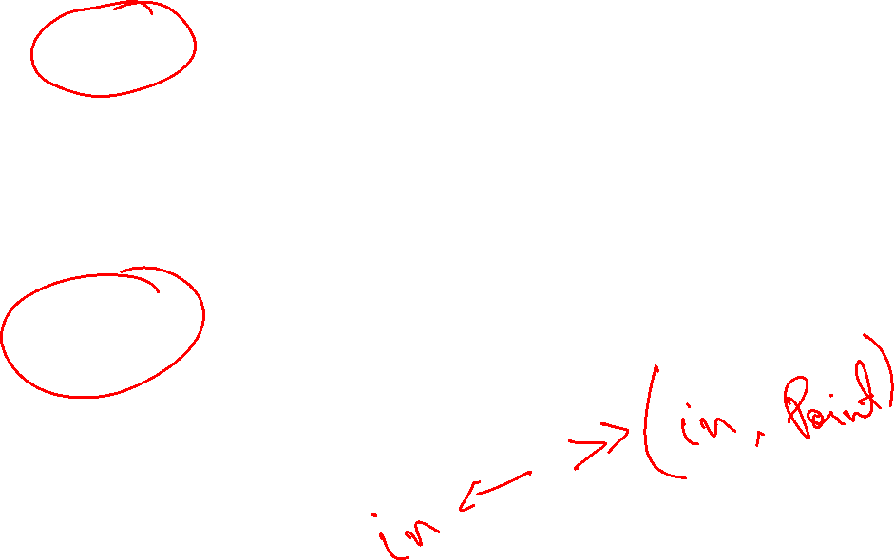
Example
ostream& operator<< (ostream &out, Point &cPoint)
{
out << "(" << cPoint.m_dX << ", " <<
cPoint.m_dY << ", " << cPoint.m_dZ <<")";
return out;
}
istream& operator>> (istream &in, Point &cPoint)
{
in >> cPoint.m_dX;
in >> cPoint.m_dY;
in >> cPoint.m_dZ;
return in;
}

Slide 78

Example
int main (void)
{
cout << "Enter a point: " << endl;
Point cPoint;
cin >> cPoint;
cout << "You entered: " << cPoint << endl;
}

Slide 79
Overloading iostream operators >> and <<
But, what is the advantage of returning references of iostream objects
friend ostream& operator<< (ostream &out, Point &cPoint);
friend istream& operator>> (istream &in, Point &cPoint);
Supports chaining
Point cPoint1, cPoint2;
cin >> cPoint1 >> cPoint2;
In above statement (cin >> cPoint1) returns a reference of cin which is further used for ( cin >> cPoint2)

Slide 80

Data Conversion
Conversion between basic types
Conversion between Objects and basic types
Conversion between Objects of different classes
Object of
Class A
Primitive
Data type
Object of
Class B

Slide 81
Implicit Conversion b/w Basic Types
When we use two different Types:
intvar = floatvar; //assign float to integer
the compiler calls a special function that converts this value from floating point format to integer
There are many such conversion routines build in C++ compiler and called upon when any such conversion is required.

Slide 82
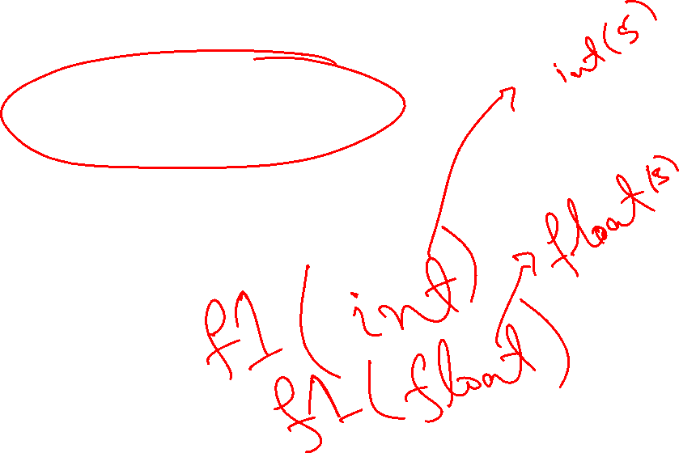
Explicit Conversion b/w Basic Types
if we want to force compiler to convert data from one native type to other, we can use explicit type casting,
intvar = int(floatvar);
it is obvious in listing that int( ) conversion function will convert from float to int.
This explicit conversion uses same build in routines.

Slide 83
Conversion Between Objects and Basic Types
To convert from a basic type ( i.e., float) to object types (i.e., Distance), we use a constructor with one argument.
Distance(float meters){ }
This function is called when an object of type Distance is created with a single argument.
This conversion allows a floating value to be assigned to a Distance type object.

Slide 84
Distance dist1=2.35; // constructor
Above, one argument constructor will be called.
Same conversion can be achieved by providing overloaded ‘=‘ operator which takes a float value as argument.

Slide 85
Conversion From User Defined to Basic
What if want to go from user-defined types(e.g. class Distance) to native type(e.g. float)?
The trick here is to overload the cast operator, creating something called a “Conversion function/operator”.
operator float() {
return floating_rep;
}
NOTE: the conversion function does not need return type
Conversion functions have no arguments, and the return type is implicitly the conversion type

Slide 86
From User Defined to Basic
This operator takes the value of the distance object of which it is a member, converts this value to a float value and returns this value.
This operator can be called like this:
Distance dist2;
float floatmtrs = float(dist2); //explicit conversion
float floatmtrs = dist2; //implicit conversion
both statements have exactly the same effect.

Slide 87
From User Defined to Basic
class Employee
{ private:
float salary;
public:
Employee ( float sal ) { salary = sal; }
operator float();
}
Employee::operator float( )
{
return salary;
}

Slide 88
From User Defined to Basic
int main ( )
{
Employee emp1(33.5);
float value = float(emp1);
cout << value; // 33.5
}

Slide 89
Conversion between Objects of Different Classes
Both methods shown before can be applied to conversion between objects of different basic types (i.e., one argument constructor, and conversion function).

Slide 90
Example
There are two classes, Polar and Rec.
We want to be able to convert an object of type Polar to an object of type Rec.
i.e., rec=pol;
provide one argument constructor in class Rec.

Slide 91
Rec(Polar p){
//process p’s data and convert(assign)
//it into object Rec.
}
rec=pol;
/*one argument constructor will be called to perform the conversion*/

Slide 92
Pitfalls of Operator Overloading and Conversion
With the help of Operator overloading we can create entirely new language.
For example for a = b + c we can implement a new methodology on user-defined types.
But care should be taken as doing something different than native data types could make your code hard to read and understand

Slide 93
Use Similar Meanings
Implement the operation of overloaded operator similar to native data types.
For example, adding two strings makes sense as we take adding as “concatenation” of two strings
but adding two “Employees” having personal data in them doesn't make much sense.

Slide 94
Show Restraint
Make sure that user of your class will easily know the purpose of overloading an operator.
Sometimes it make more sense to use functions, as their names may suggest what they are to perform.
Use overloaded operator sparingly and only when the usage is obvious.
Notes:
Restraint is self-control

Slide 95
String Library
We will use operator overloading to build String library
Overloaded Operators
= (for text assignment)
== (for comparison between two strings)
ostream and istream (for cin and cout)
+ (for adding two strings)
[ ] (for retrieving or changing single character in string)

Slide 96
String Library
class String
{
private:
char *text;
public:
String(char *str)
{
text = new char[strlen(str)];
strcpy(text,str);
}
bool operator==(String &str);
bool operator==(char *str);
String& operator+(String &str);
String& operator+(char *str);
void operator= (char *str);
char& operator[] (int Index);
friend ostream& operator<<(ostream &,String &str);
friend istream& operator>>(istream &,String &str);
};

Slide 97
String Library
bool String::operator == ( char *str )
{
bool val;
val = strcmp(text,str);
if ( val == 0 )
return true;
else
return false;
}
bool String::operator == ( String &par)
{
bool val;
val = strcmp(text,par.text);
if ( val == 0 )
return true;
else
return false;
}

Slide 98
String Library
String& String::operator + (String &par)
{
String iSt = "";
int length = 0;
length = strlen(text);
length += strlen(par.text);
iSt.text = new char[length];
strcpy(iSt.text,text);
strcat(iSt.text,par.text);
return iSt;
}

Slide 99
String Library
String& String::operator + (char *str)
{
String iSt = "";
int length = 0;
length = strlen(text);
length += strlen(str);
iSt.text = new char[length];
strcpy(iSt.text,text);
strcat(iSt.text,str);
return iSt;
}

Slide 100
String Library
void String::operator = (char *str)
{
text = new char[ strlen(str) ];
strcpy(text,str);
}
char& String::[] (int Index)
{
return text[Index];
}
// String string1 = “hello”;
// string1[0] = ‘a’;
// string1.text[0] = ‘a’;
// char c = string1[0];

Slide 101
String Library
ostream& operator<< (ostream &out, String &str)
{
out << str.text;
return out;
}
istream& operator>> (istream &in, String &str)
{
char temp[200];
in >> temp;
text = new char[strlen(temp)];
strcpy(text,temp);
return in;
}

Slide 102
String Library
int main ( )
{
String string1 = “hello”;
String string2 = “”;
string1 = “hello world”;
cout << “Enter string 2 text” << endl;
cin >> string2;
if ( string1 == string2 )
cout << “Both strings are equal” << endl;
string2[0] = ‘a’;
string2[1] = ‘b’;
cout << “The second string is “ << string2 << endl;
cout << the first character is “<< string1[0] << endl;
}

